Slide 1
Deep Graph Library 101
Lingfan Yu & DGL Team
New York University, NYU Shanghai, Amazon AWS, Amazon Shanghai AI Lab
KDD 2019 Hands On Tutorial
http://dgl.ai

Slide 2
Outline for this session
Introduction (10 mins):
Why do we need a new tool for writing GNNs?
Hands-on Tutorial (35 mins):
Write a popular GNN: Graph Convolution Network [ICLR’17]
Use GCN to to perform community detection

Slide 3
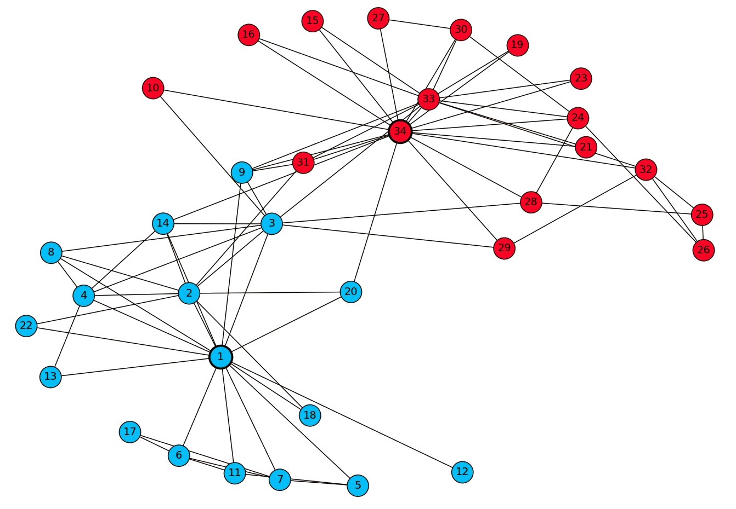
Zachery's Karate Club
Nodes: club members
Node 1 is club instructor
Node 34 is club president
Edges: interaction outside club between members
The task: predict for each member which community (instructor or president) he belongs to

Slide 4
How GNN solves this problem?
Graph Neural Network (GNN): learn embedding on nodes/edges/graphs
GNN
Classifier

Slide 5
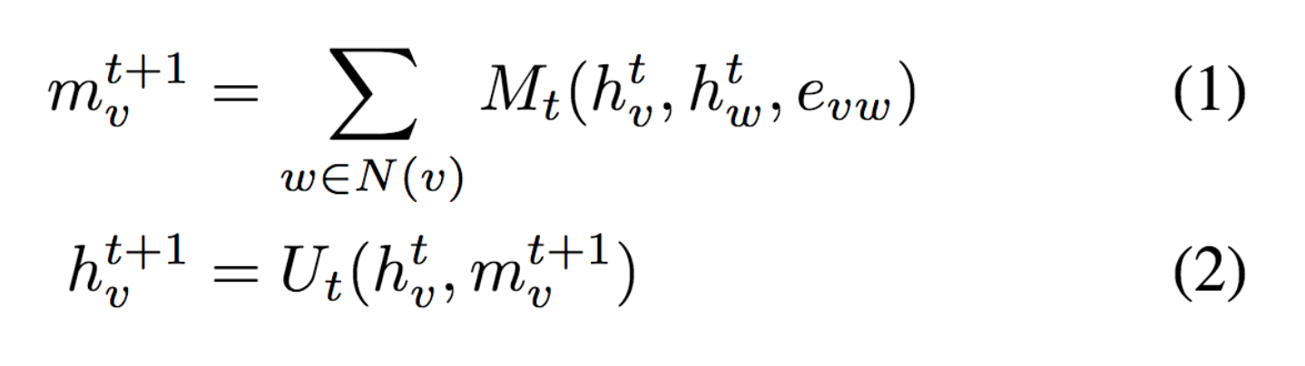
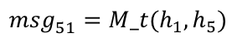
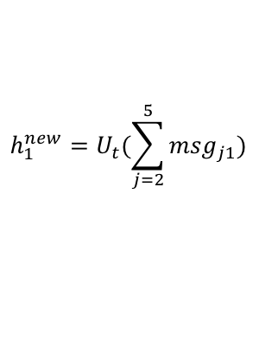
How GNN learns embeddings
GNN is based on message passing
h₅
h₂
v₅
Reduce
v₂
Message
$${msg}_{51}^{}={M_t(h_{1},h}_{5})$$
v₁
$$h_{1}^{new}=U_{t}(\sum_{j=2}^{5}{{msg}_{j1}})$$
v₃
v₄
Neural Message Passing for Quantum Chemistry
h₄
h₃
Notes:
Message: tensor computed from source node/ destination node/ edge features
Reduce: aggregating the messages (and updating the node representation accordingly)

Slide 6
How GNN is trained
Step 0:
Associate each node / edge with input features (an embedding vector)

Slide 7
How GNN is trained (cont’d)
Step 1:
Perform message passing for a fixed number (a pre-defined constant) of iterations
Both are parameterized neural network modules
Notes:
Use local neighborhood info

Slide 8
How GNN is trained (cont’d)
Step 2:
Use the GNN-outputted embedding for training tasks to calculate loss
Step 3:
Minimize loss with backward propagation
Community 0
Classifier
Cross Entropy Loss
Community 1
Community 1

Slide 9
Why do we need a new tool for GNN?

Slide 10
Existing tools do not support GNNs well
Writing GNNs is hard in TensorFlow/Pytorch/MXNet.
(Our implementation) caused OOM … which is the reason for the lack of results on PubMed.
-- Reply in OpenReview from authors of Graph Attention Network [ICLR’18]

Slide 11
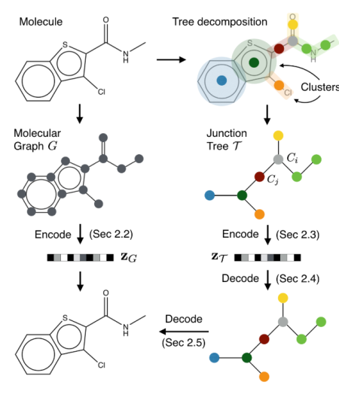
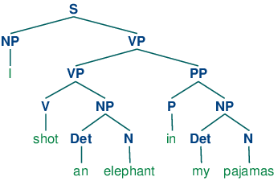
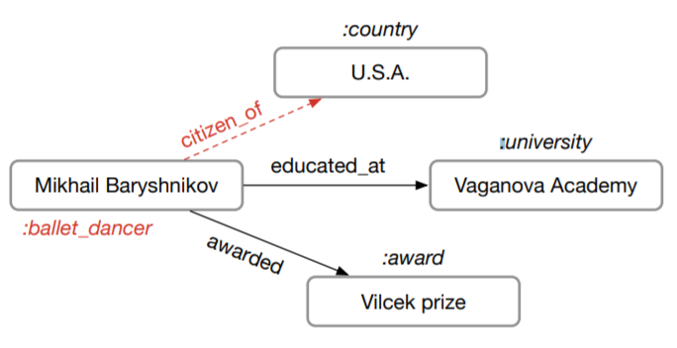
Existing implementations are often slow
Sentence Parse Tree
[Tai et al. ACL’15]
Molecule Graph
[Jin et al. ICML’18]
Knowledge Base
[Schlichtkrull et al. arxiv’17]
Training speed of one popular PyTorch version is only 23 trees/s
Author’s code in PyTorch: 8.25 graphs/s
Cannot run on GPU
due to OOM

Slide 12

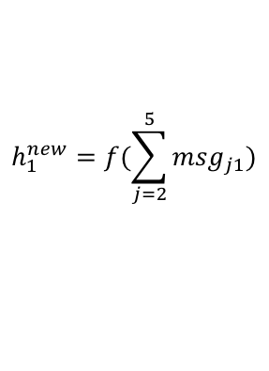
Why is programming GNN hard?
GNN is based on message passing
Tensorflow/Pytorch/MXNet provides tensor programming
h₅
h₂
v₅
v₂
$${msg}_{51}^{}=h_{5}$$
v₁
$$h_{1}^{new}=f(\sum_{j=2}^{5}{{msg}_{j1}})$$
v₃
v₄
h₄
h₃
How tensors are transformed
On edge: how messages are calculated
On node: how messages are aggregated and consumed

Slide 13
Our solution: A Graph-centric Library DGL
GNN Models
Define computation over graph structure and batches execution on nodes and edges
DGL
Batch multiple graphs together for efficiency
Message Passing
Graph Sampling
Batched Graphs
…
Flexible interfaces for sampling from giant graphs
Pytorch
MXNet
more is coming …
Compilers (TVM (Neo), ONNX)
GPU, FPGA, IP core, Arm …
Notes:
Later two sessions will be using different backend.

Slide 14
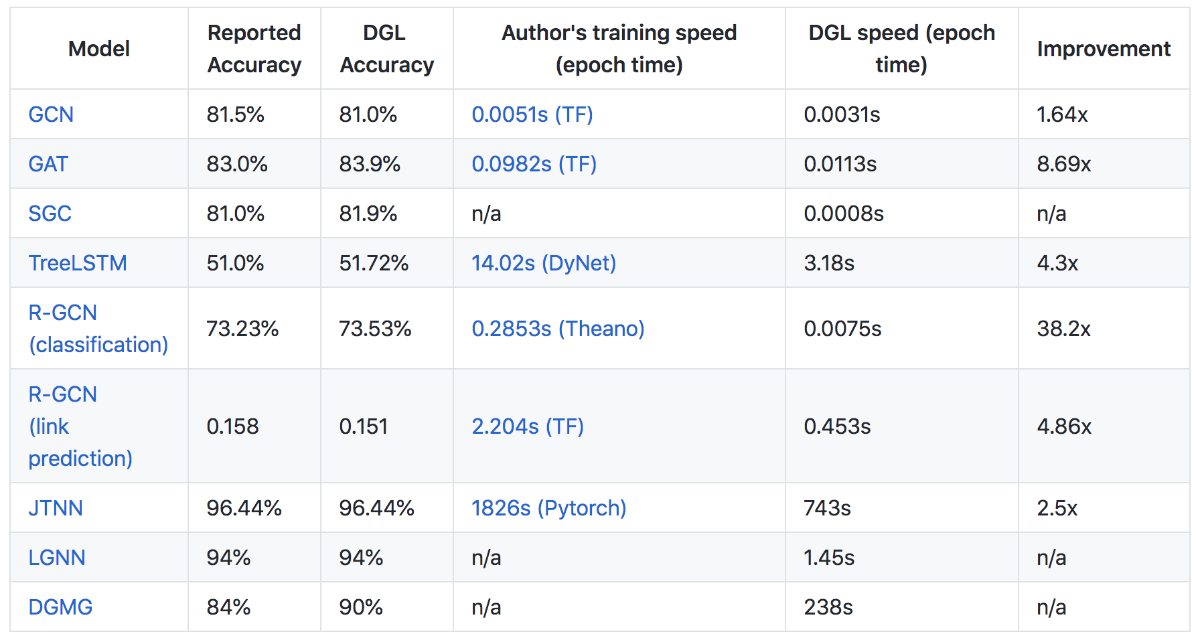
DGL is fast

Slide 15
DGL’s offers
10+ off-the-shelf most popular GNN models (w/ detailed tutorials)
A central repo for 9 popular GNN datasets (cora, pubmed, …)
Easy developing for advanced GNNs:
Sampling for Large graphs
PinSAGE [WWW’18], [Jianfei et al., ICML’18], FastGCN [ICLR’18], …
Dynamic graphs
JTNN [ICML’18], DGMG [CVPR’18], …
Batching of Multiple graphs
TreeLSTM [ACL’15], GAT [ICLR’18], …

Slide 16
Resources
DGL website: http://dgl.ai/
DGL GitHub Repository: https://github.com/dmlc/dgl
DGL discuss forum: https://discuss.dgl.ai/
Please try it! And we hope to see your contributions!!

Slide 17
Now let’s move on to write a GCN with DGL
1_community_detection/community_detection.ipynb

